Slide 1
Redaction Poetry
Blackout Poetry for Creative Journal Pages
Examples are not mine but collected through various websites

Slide 2
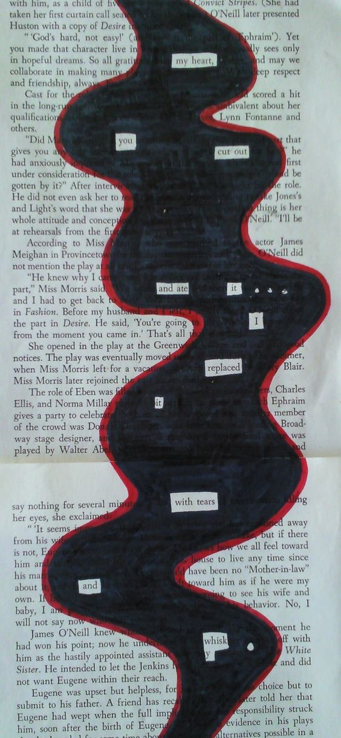
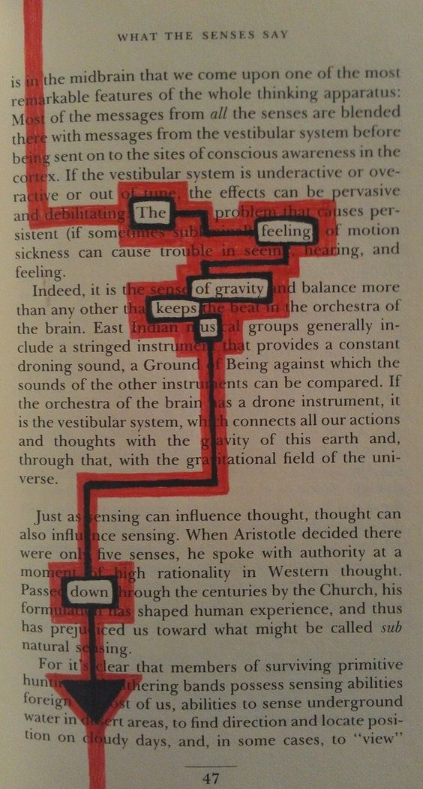
Isolate terms and phrases

Slide 3
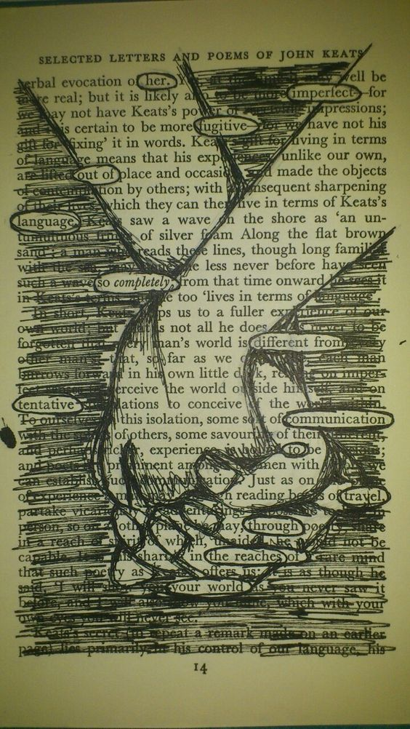
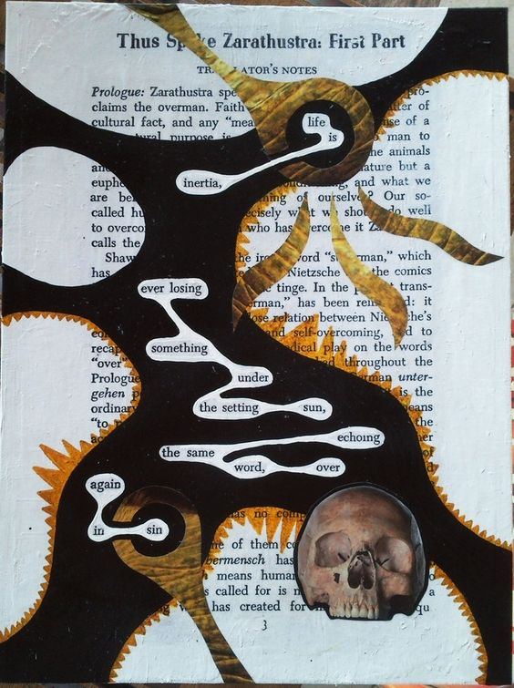
Draw over and collage

Slide 4
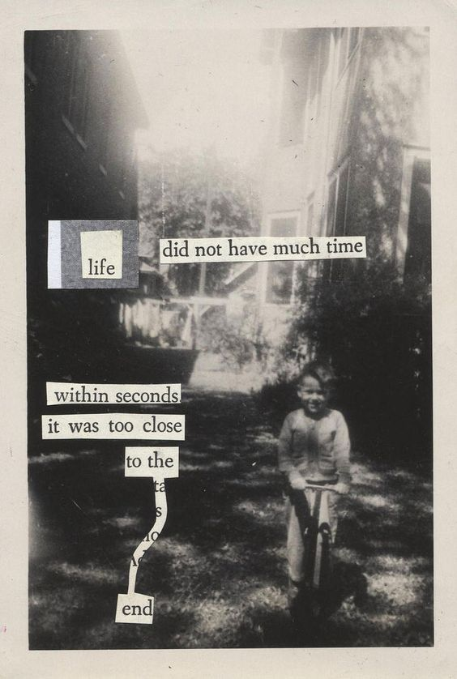
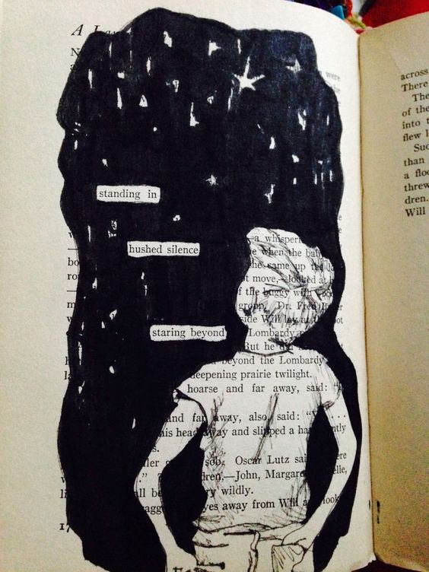
Collage terms and phrases over images block out large areas

Slide 5
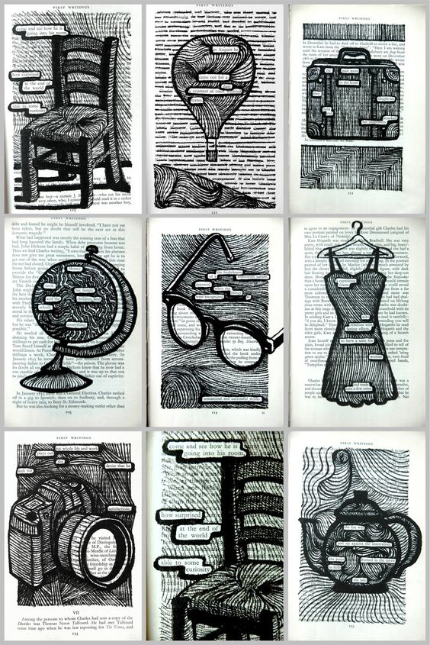
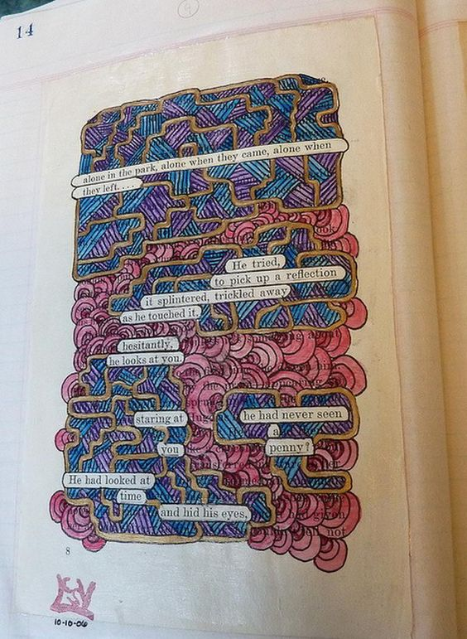
Doodle your page with design and images

Slide 6
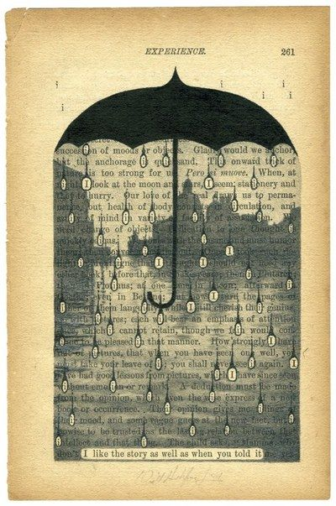
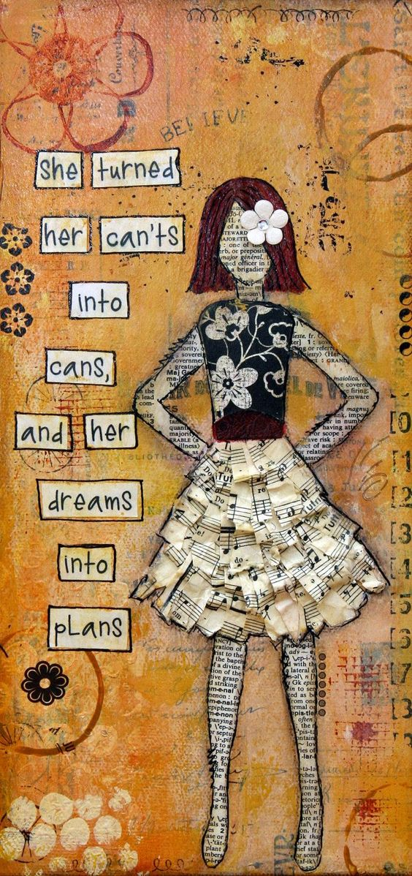
Isolate letters and to emphasize the poem. Make your own poem and font add texture – there are no rules

Slide 7
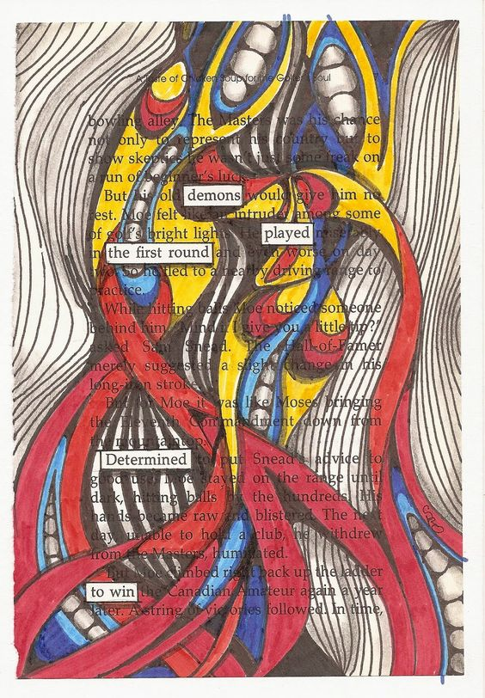
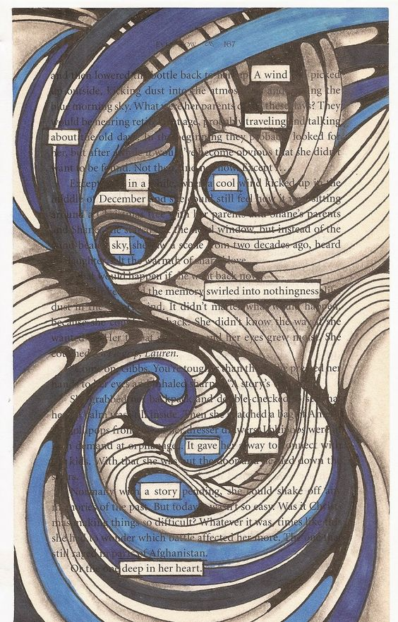
Expressive line and color help to offset the poem

Slide 8
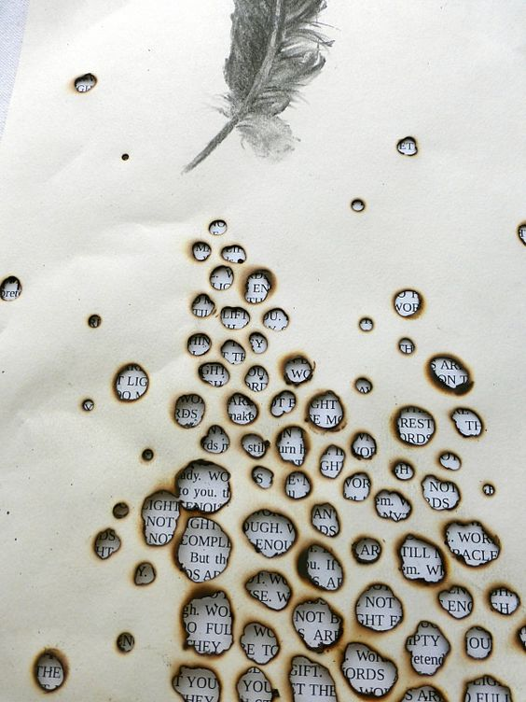
Texturize and experiment with the paper and background/ foreground

