Slide 1
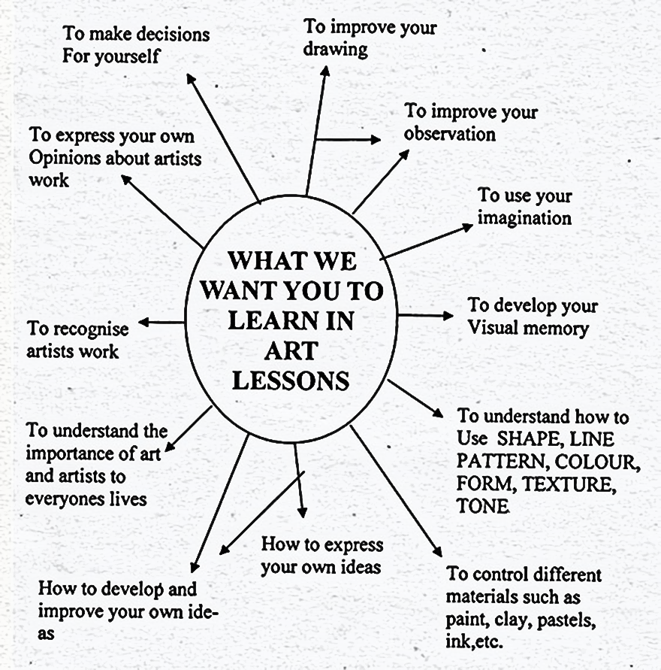
Mind Mapping
A Visual Organization Process

Slide 2
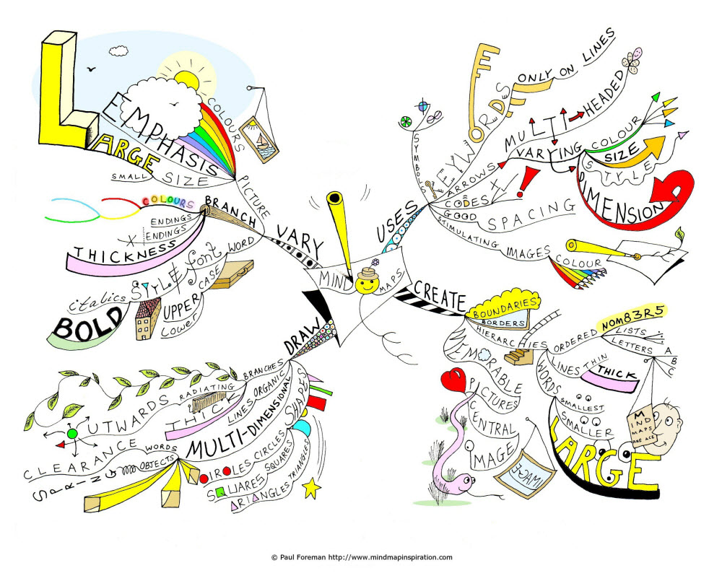
What is a mind map?
A mind map is a diagram used to visually organize information.
It is often created around a single concept, drawn as an image in the center of a blank page, to which associated representations of ideas such as images, words and parts of words are added.
Major ideas are connected directly to the central concept, and other ideas branch out from those.
Mind maps can be drawn by hand, either as "rough notes" during a lecture, a planning session.
Mind maps are also called spider grams or sun bursting.

Slide 3
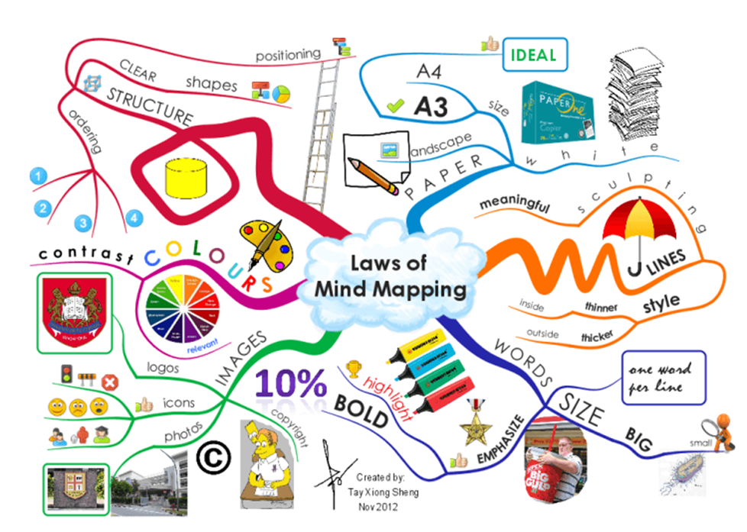
As with other diagramming tools, mind maps can be used to generate, visualize, structure and classify ideas, and as an aid to studying and organizing infor-mation, solving problems, making decisions, and writing.

Slide 4
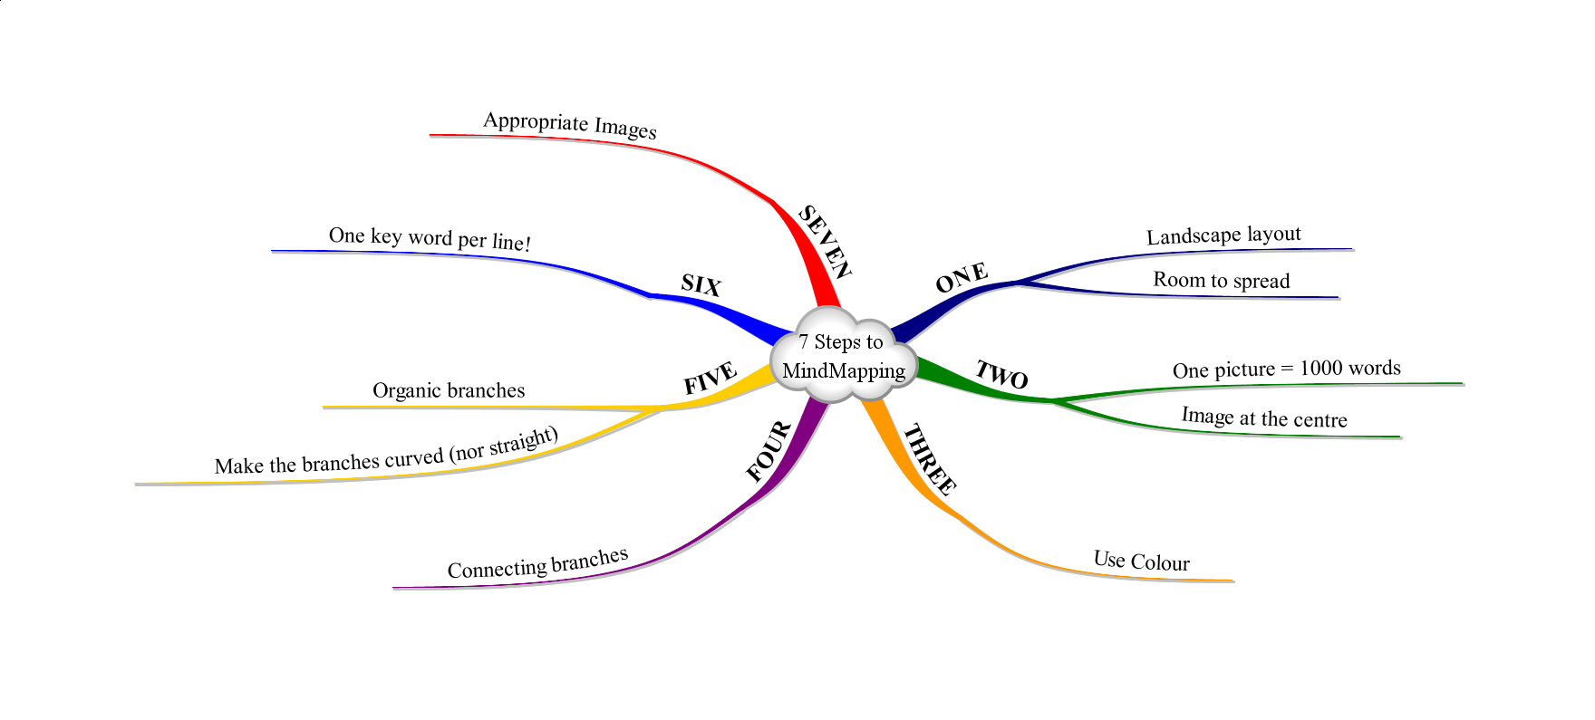
Mindmapping Steps:

Slide 5
Mindmapping Steps:
Make the lines the same length as the word/image they support.
Use multiple colors throughout the mind map, for visual stimulation and also for encoding or grouping.
Develop your own personal style of mind mapping.
Use emphasis and show associations in your mind map.
Keep the mind map clear by using radial hierarchy or outlines to embrace your branches.
Start in the center with an image of the topic, using at least 3 colors.
Use images, symbols, codes, and dimensions throughout your mind map.
Select key words and print using upper or lower case letters.
Each word/image is best alone and sitting on its own line.
The lines should be connected, starting from the central image. The lines become thinner as they radiate out from the center.

Slide 6
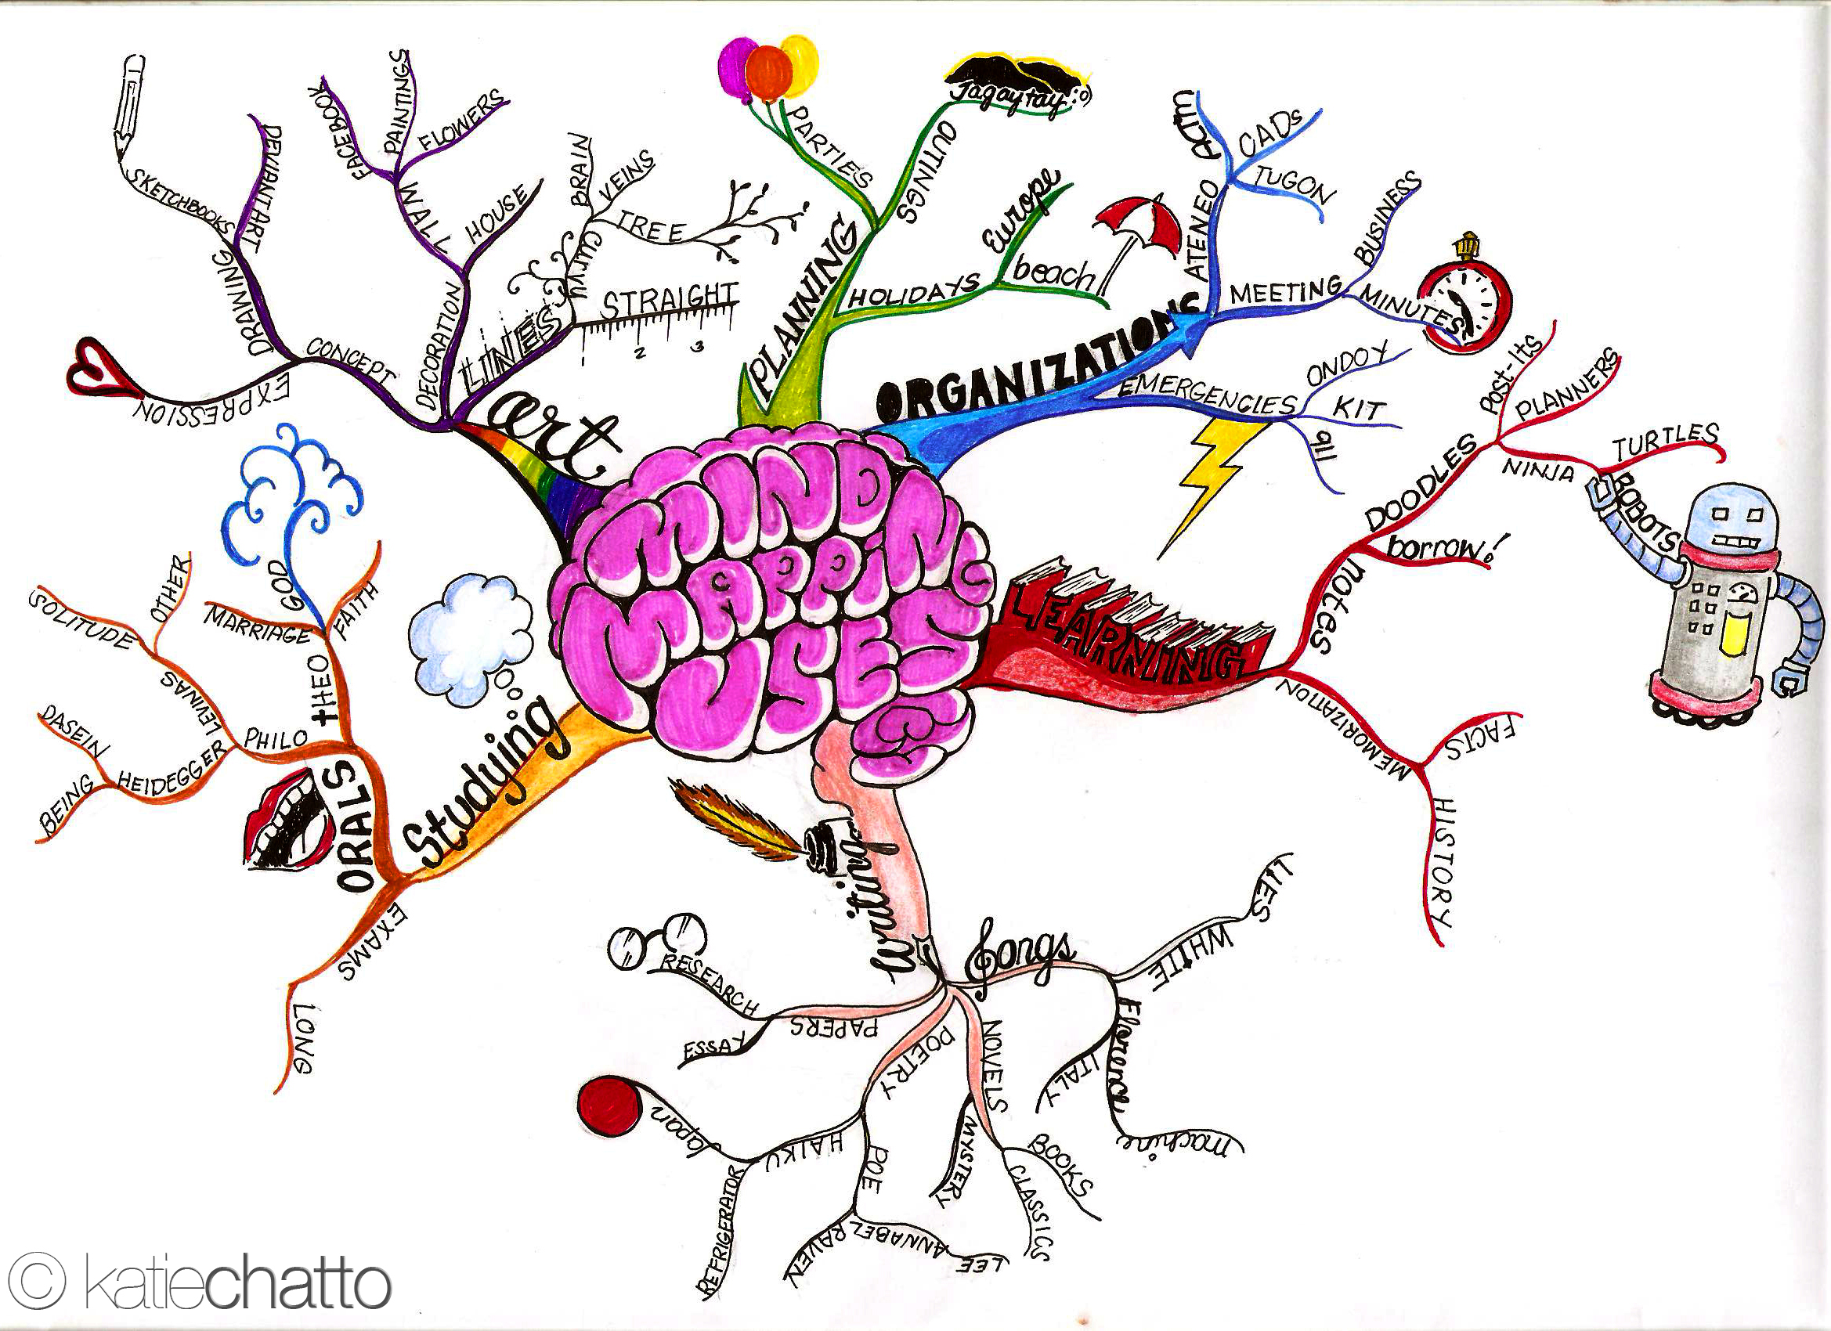
Mind Map Samples
You can find many more on Google Images or Pinterest

Slide 7
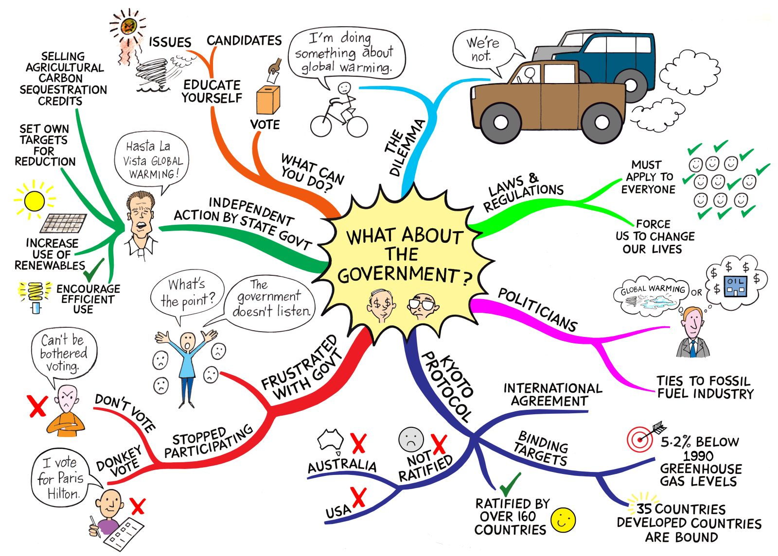

Slide 8
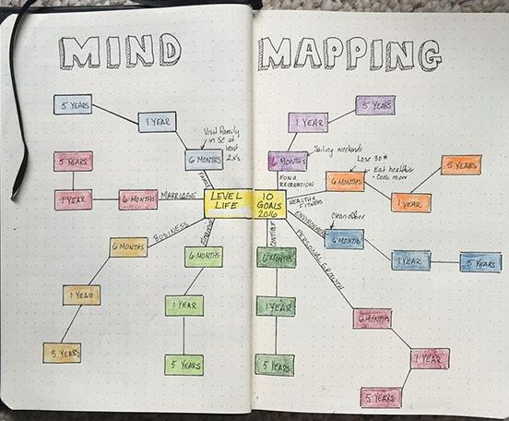

Slide 9
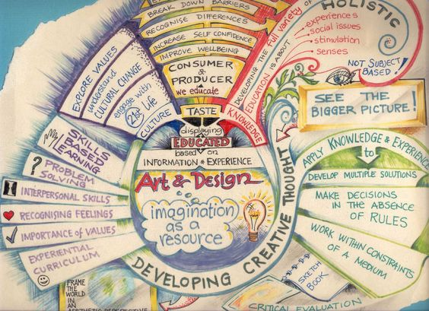

Slide 10
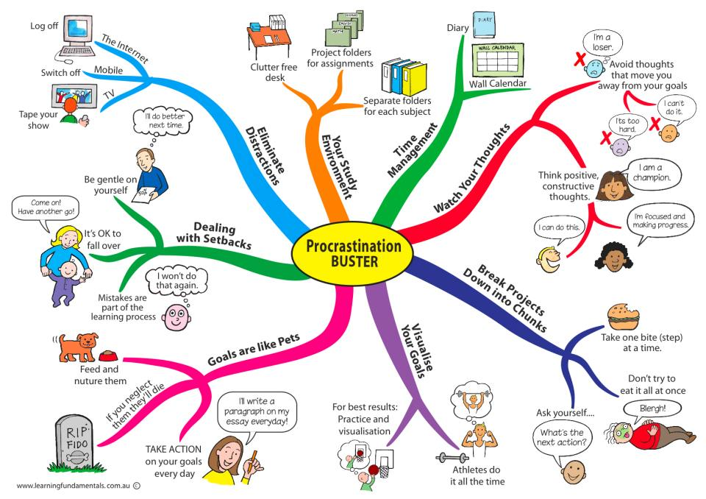

Slide 11
