Slide 1
L i N E
I do not know who originally created this PowerPoint as to give credit. I did customize for my courses.

Slide 2
Bridget Riley
Line
The path of a continuous, moving point through space.
Line is important to an artist because it can describe and identify shapes.
Line appears only in 2 dimension, in reality it reflects edges and contrast in form and elements.

Slide 3
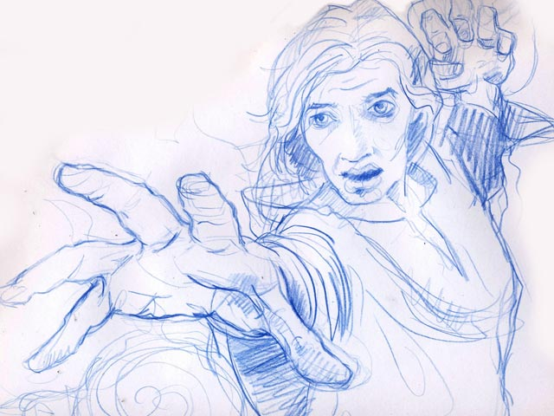
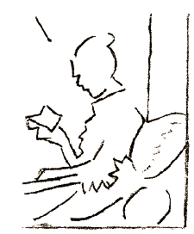
Types of Lines
TYPES OF LINES
ACTUAL LINE
May vary greatly in weight and
character
-Basic Lines
-Expressive Lines
-Descriptive Lines
IMPLIED LINE
Created by positioning a series of points
so that the eye tends to automatically connect them—not actually drawn!
By using the various types of lines, artists have the
potential to lead a viewer’s eye through a composition.

Slide 4
%5 Basic Types of Lines
ACTUAL LINE
5 BASIC LINES
VERTICAL
HORIZONTAL
DIAGONAL
CURVED
ZIG-ZAG

Slide 5
VARIATIONS OF LINE QUALITY
Length
Width
TEXTURE
direction
degree
of
curve
With the combination of various line types, a multitude of possible effects can be created.

Slide 6
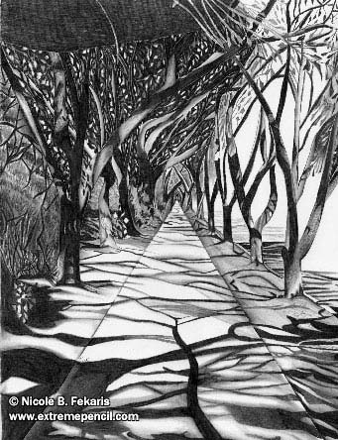
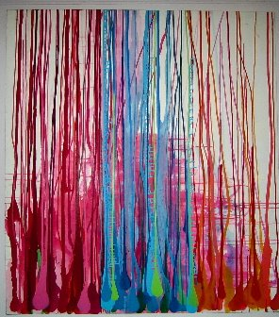
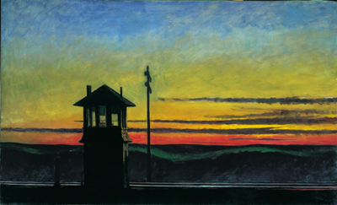
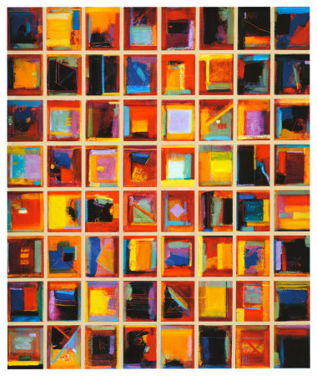
ACTUAL LINE
EXPRESSIVE LINES
Lines that communicate ideas & moods.
Curved & Zig-Zag?
How about this one?
Horizontal Lines?
What do you feel when you see vertical lines used in an artwork?

Slide 7
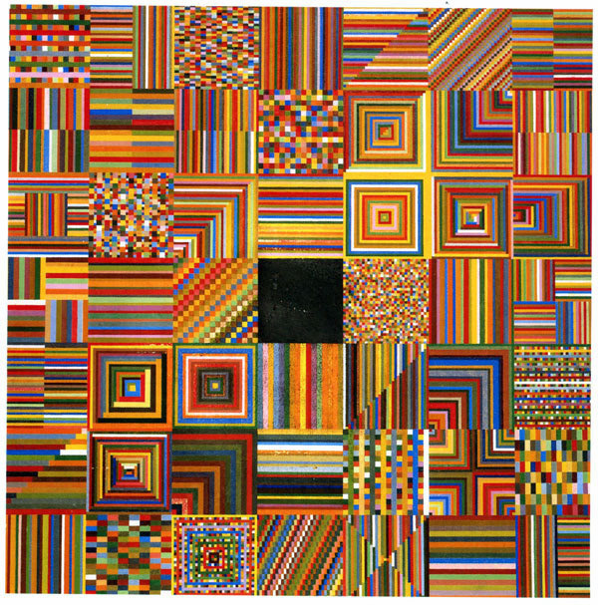
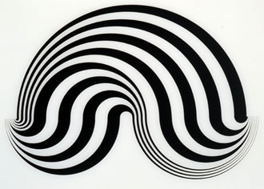
Vertical Lines
stability and strength
Horizontal Lines
calm and peaceful
Diagonal Lines
instability, indicates movement
Curved Lines
change of direction, sense of activity
Zig-Zag Lines
tension and confusion

Slide 8
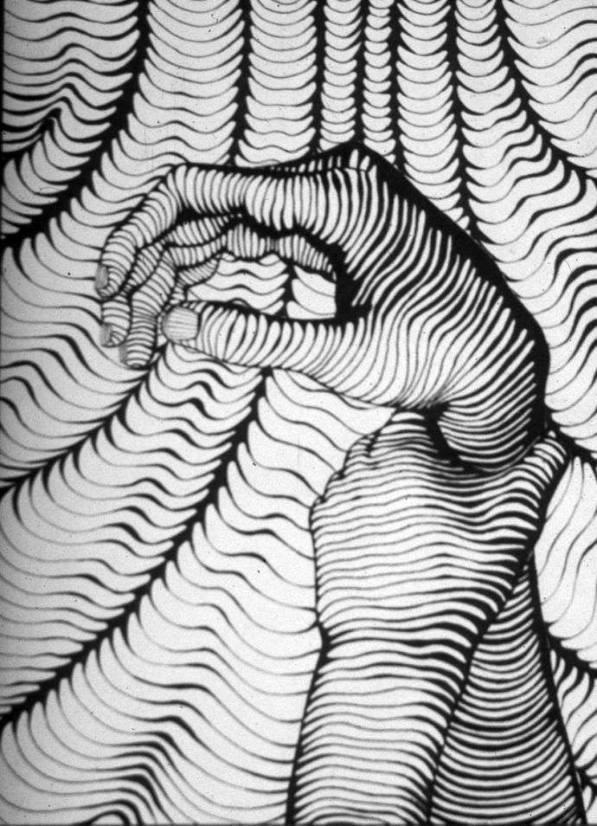
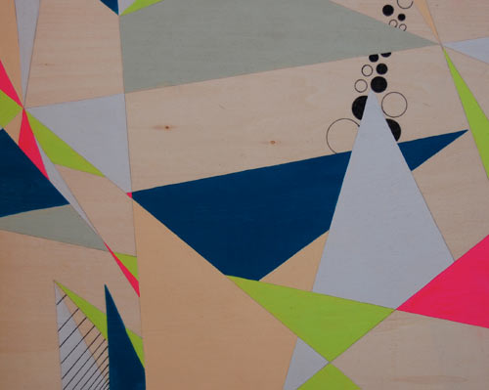
Design Techniques
Overlap
Elements that partially cover another element.
Beth Goolsby

Slide 9
Weave – alternating over under overlaps of linear designs
Through – an element going in one side and out another area of the same element.
Jane Priser
Jim Warren

Slide 10
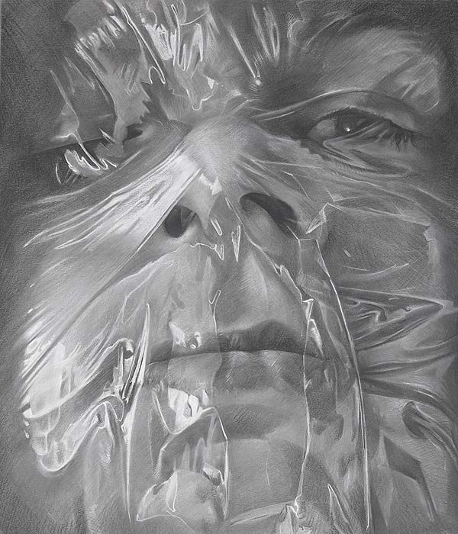
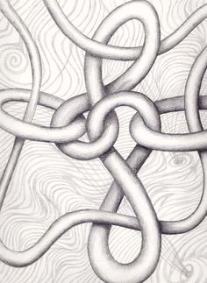
Wrap – to cover or coil around
Intertwine – to be tangled or knotted
Scott Hutchinson
Celtic design
Graham Matthews
Giel Djensen

Slide 11
ACTUAL LINE
DESCRIPTIVE LINES
Lines that DESCRIBE how an object looks.
TYPES OF DESCRIPTIVE LINE
contour
gesture

Slide 12
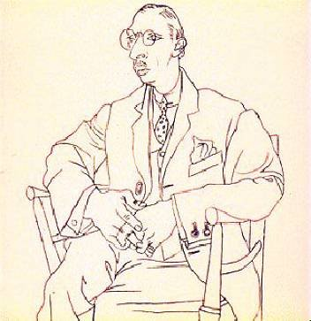
DESCRIPTIVE LINES
CONTOUR LINES
Line used to follow the
edges of forms, to describe
their outlines and inner details.
This is the most common use of
line in art.
Contour lines describe the wrinkles & folds in your clothes.

Slide 13
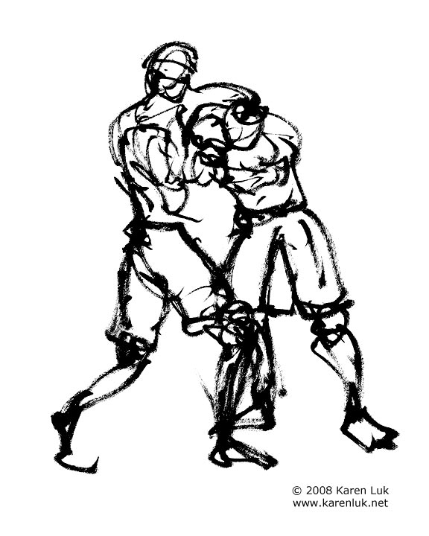
DESCRIPTIVE LINES
GESTURE LINES
Quick, sketch-like lines
Your drawn lines don’t stay at the edges but move freely within the forms.
You are more concerned with capturing the ACTION rather than drawing accurately.
It captures the movement of the subject rather than recording the details of the form.

Slide 14
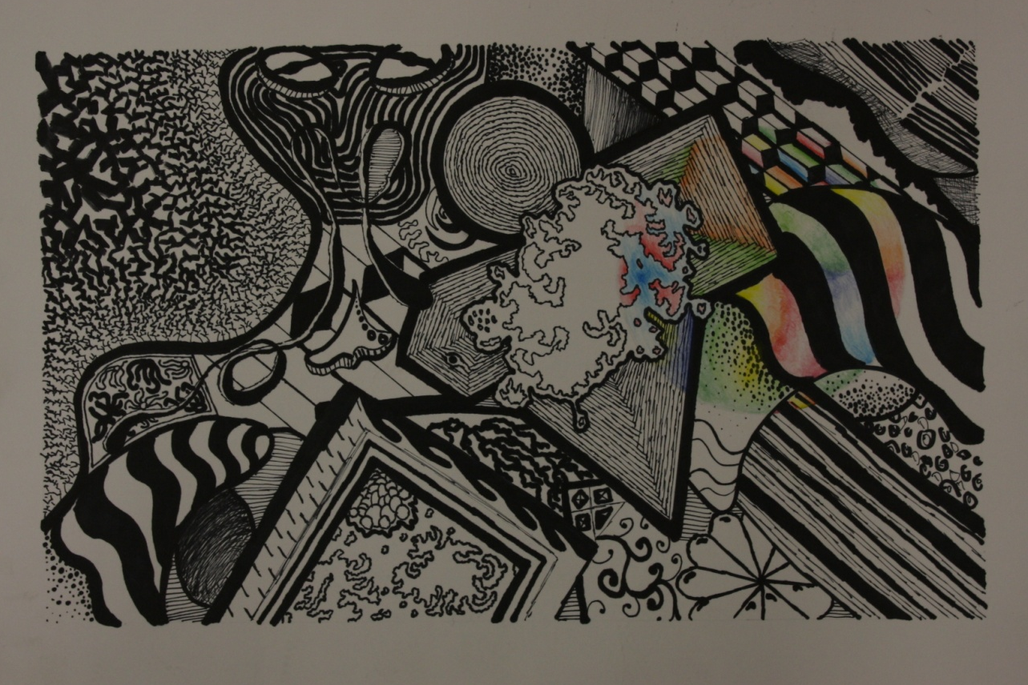
NOW WHAT???
It’s your turn to
EXPRESS YOURSELF WITH LINE!!!

Slide 15
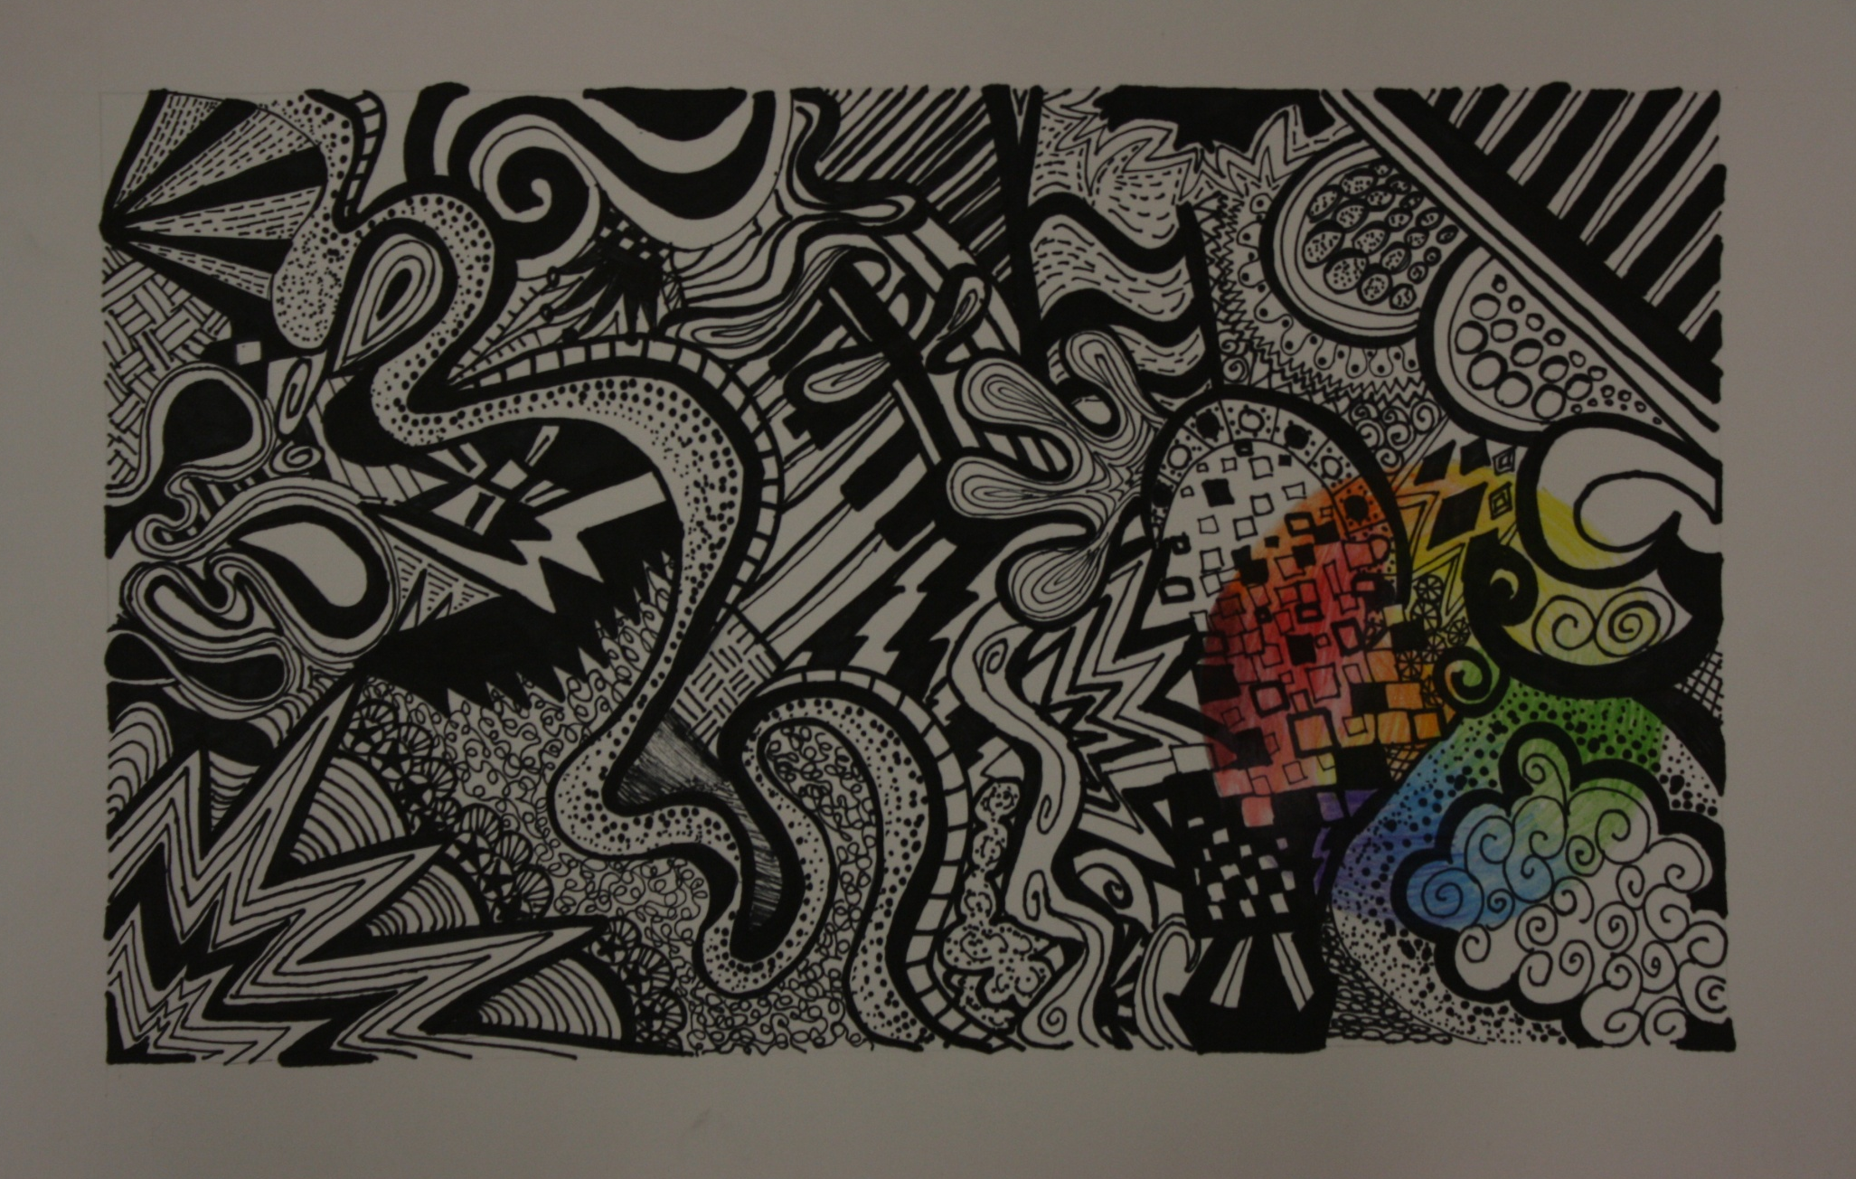

Slide 16
Criteria
WRITE THESE DOWN IN YOUR NOTES!
In sketchbook divide page into 16 equal areas. BRAINSTORM 16 different linear thumbnails filling each area.
CREATE A 5” x 7” rough draft IN PENCIL in sketchbook.
Final design – Use a 9x12 sheet of drawing paper
Only use SHARPIE MARKER (FINE & EXTRA OR ULTRA FINE)
ONE INCH BORDERS
Must use ALL 5 BASIC LINES; horizontal, vertical, diagonal, curved and zigzag
Must use ALL 5 VARIATIONS OF LINE; Length, width, texture direction and degree of curve.
Must use all 5 DESIGN TECHNIQUES; overlap, weave, wrap, through and intertwine.
Ratio of BLACK & WHITE must be EQUAL
NO SCRIBBLES—Lines must be CONTROLLED
NO WORDS/NAMES/NUMBERS
Focus on CRAFTSMANSHIP (be neat)
If you make a mistake, turn it into something else, there is NO ERASING!
Art Project General Rubric will be used for grading the above criteria.

Slide 17
Essential Standards
Student will be able to -
BV 1.2 Apply elements and principles to create an art work
BV 2.1 Understand the importance of planning
BV 2.2 Understand the relationship of sensory awareness and artistic expression
BCR 1.2 Us teacher generated criteria to evaluate personal art

